Slide 1
Divide and Conquer
AOA : Module 2

Slide 2
Contents
Binary Search
Find Maximum and Minimum
Merge Sort
Quick Sort
Strassen’s Matrix Multiplication
Heap Sort

Slide 3
Introduction
Original problem is divided into similar kind of subproblems that are smaller in size and easy to be find.
The solution of these small independent subproblems are combined to obtain the solution of whole problem.
Divide and Conquer paradigm solves a problem in three steps at each level of recursion:
Divide
Conquer
Combine

Slide 4
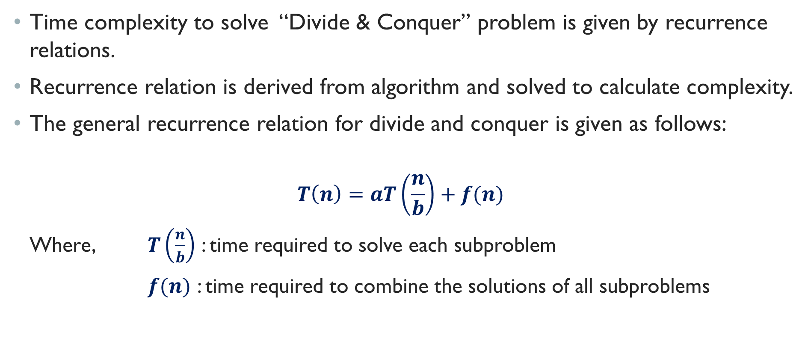
Introduction
Time complexity to solve “Divide & Conquer” problem is given by recurrence relations.
Recurrence relation is derived from algorithm and solved to calculate complexity.
The general recurrence relation for divide and conquer is given as follows:
$$T\left(n\right)=aT\left(\frac{n}{b}\right)+f(n)$$
Where, $T\left(\frac{n}{b}\right)$ : time required to solve each subproblem
$f(n)$ : time required to combine the solutions of all subproblems

Slide 5
Binary Search
There are two approaches:
Iterative or Non-recursive
Recursive
There is a linear Array ‘a’ of size ‘n’.
Binary Search is one of the fastest searching algorithm.
Binary Search can only be applied on “Sorted Arrays”- either ascending or descending order.
We compare “key” with item in the middle position. If they are equal, search ends successfully.
Otherwise,
if key is less than element present in the middle position,
then apply binary search on lower half,
else apply BINARY SEARCH on upper half of the array.
Same process is applied to remaining half until match is found or there are no more elements left

Slide 6
Binary Search
Iterative Approach:
Algorithm IBinaryS(arr[ ], start, end, key){
int mid;
while(start<=end){
mid = (start + end)/2;
if (arr[mid] == key)
return 1;
if (arr[mid]<key)
start = mid+1;
else
end = mid-1;
}
return 0;
}
Recursive Approach:
Algorithm RBinaryS(arr[ ], start, end, key){
int mid;
if (start > end) { return 0; }
else
mid = (start + end)/2;
if (key == arr[mid])
return (mid);
else
if (key < arr[mid]){
RBinaryS(arr[],key, start, mid-1)
else
RBinaryS(arr[],key, mid+1, end)
}
}

Slide 7
Finding minimum and maximum
Iterative Approach:
Algorithm MinMax(a[ ], n, max, min){
max=min=a[1];
for(i=2 to n)do
{
if(a[i]> max) then max=a[i];
if (a[i]< max) then min=a[i];
}
}
Recursive Approach:
Algorithm MinMax(a[ ], l, h, max, min) {
if(l==h) then
max=min=a[l];
else if (h-l==1), then
{
if(a[l]>=a[h]), then
max=a[l];
min=a[h];
else{
max=a[h];
min=a[l];
}
else{
Mid = (l+h)/2;
MinMax(l, mid, max, min);
MinMax(mid+1, h, max, min);
if(max< max1) then max=max1;
if (min>min1)then, min = min1;
}
}

Slide 8
Finding minimum and maximum
Recursive Approach:
Algorithm MinMax(a[ ], l, h, max, min) {
if(l==h) then
max=min=a[l];
else if(h-l==1), then
{
if(a[l]>=a[h]), then
max=a[l];
min=a[h];
else{
max=a[h];
min=a[l];
}
else{
Mid = (l+h)/2;
MinMax(l, mid, max, min);
MinMax(mid+1, h, max1, min1);
if(a[max]< a[max1]) then max=max1;
if (a[min]>a[min1])then,
min = min1;
}
}

Slide 9

Finding minimum and maximum
Time Complexity:
Recurrence relation :
$$T\left(n\right)=2T\left(\frac{n}{2}\right)+2 n>2$$
$$=1 n=2$$

Slide 10
Merge Sort
Simple and efficient algorithm for sorting a list of numbers
Based on divide and Conquer paradigm
Performed in three steps:
Divide:
List of n elements is divided into 2 sub-lists of n/2 elements
Computes middle of the array, so it takes constant time O(1).
Conquer:
Each half is sorted independently.
Merge sort is recursively used to sort elements of smaller sub-lists.
This step contributes T(n/2) + T(n/2) to running time.

Slide 11
Merge Sort
Combine:
Two sorted halves are merged to obtain a sorted sequence
This requires merging of n elements into 1 list.
It contributes O(n) to running time.
NOTE: The Key operation of merge sort is Merging

Slide 12
Merge Sort Algorithm
mergeSort(arr[ ],low, high)
//arr is array, low is left sub-list, high is right sub-list
{
if(low<high)
{
mid = (low+high)/2;
mergeSort(arr, low, mid);
mergeSort(arr,mid+1,high);
merge(arr, low, mid, high);
}
}

Slide 13
Merge Algorithm
void merge(int arr[ ], int low, int mid, int high) {
int i = low;
int j = mid + 1;
int k = low;
/* create temp array */
int temp[5];
while (i <= mid && j <= high) {
if (arr[i] <= arr[j]) {
temp[k] = arr[i];
i++;
k++;
}
else {
temp[k] = arr[j];
j++;
k++;
}
}
1
2

Slide 14
Merge Algorithm
/* Copy the remaining elements of first half, if there are any */
while (i <= mid) {
temp[k] = arr[i];
i++;
k++;
}
/* Copy the remaining elements of 2nd half, if there are any */
while (j <= high) {
temp[k] = arr[j];
j++;
k++;
}
3
4
/* Copy the temp array to original array */
for (int k = low; k <= high; k++) {
arr[k] = temp[k];
}
}
5

Slide 15
Merge Sort Example
Example:
54 | 26 | 93 | 17 | 77 | 31 | 44 | 55

